Slide 1
Design and Development of Topical Chatbot
Zishan Sher
GitHub: https: //github.com/xeeshan-dev

Slide 2
Abstract
This project aims to develop a sentiment-aware chatbot using Transformer-based architecture. Leveraging the 'Topical Chat' dataset, the chatbot demonstrates domain-specific conversational capabilities. It involves preprocessing, training, and evaluation stages to achieve precision and relevance in responses.

Slide 3
Workflow Overview
Key stages of the project:
1. Data Loading and Preprocessing
2. Model Design
3. Training
4. Evaluation

Slide 4
Data Preprocessing
Preprocessing steps:
- Lowercasing
- Punctuation removal
- Removal of unnecessary characters
Dataset statistics:
- Conversations: 8,000+
- Messages: 184,000+
- Sentiments: 8 categories

Slide 5
Model Architecture
Transformer-based Encoder-Decoder:
- Input: Preprocessed text and sentiment labels
- Layers: Attention mechanism and latent dimensions
- Output: Sentiment-aware responses
Key Hyperparameters:
- Batch size: 64
- Epochs: 200
- Optimizer: Adam

Slide 6
Results and Evaluation
Performance Metrics:
- Precision: 87%
- Recall: 84%
- F1-Score: 85%
Challenges:
- Handling out-of-domain queries
- Improving fallback responses

Slide 7
Future Improvements
Suggested improvements:
- Expand dataset for better generalization
- Implement reinforcement learning for optimization
- Integrate hybrid models to handle ambiguous queries

Slide 8
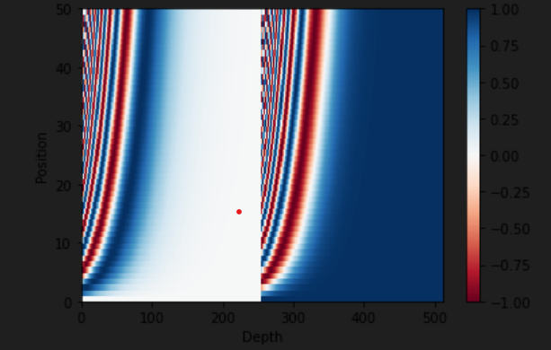
CONCLUSIONS
Adds positional information to token embeddings.
Visualizes sinusoidal encoding patterns.
Distinguishes sequence positions effectively.
Essential for understanding token order.

Slide 9
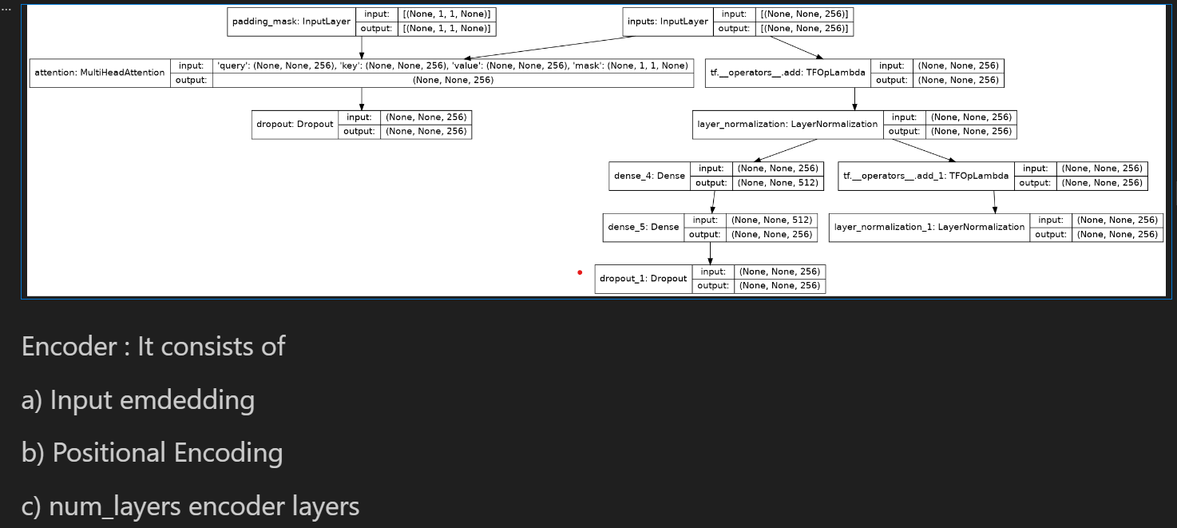
ENCODINGLAYER

Slide 10
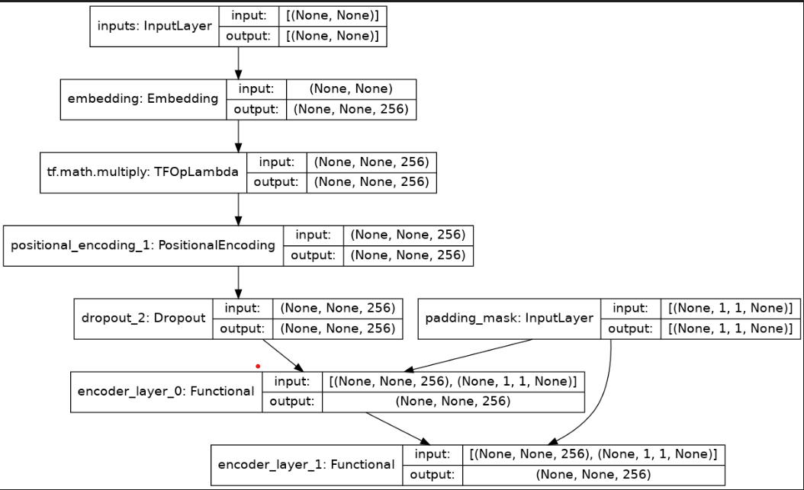

Slide 11
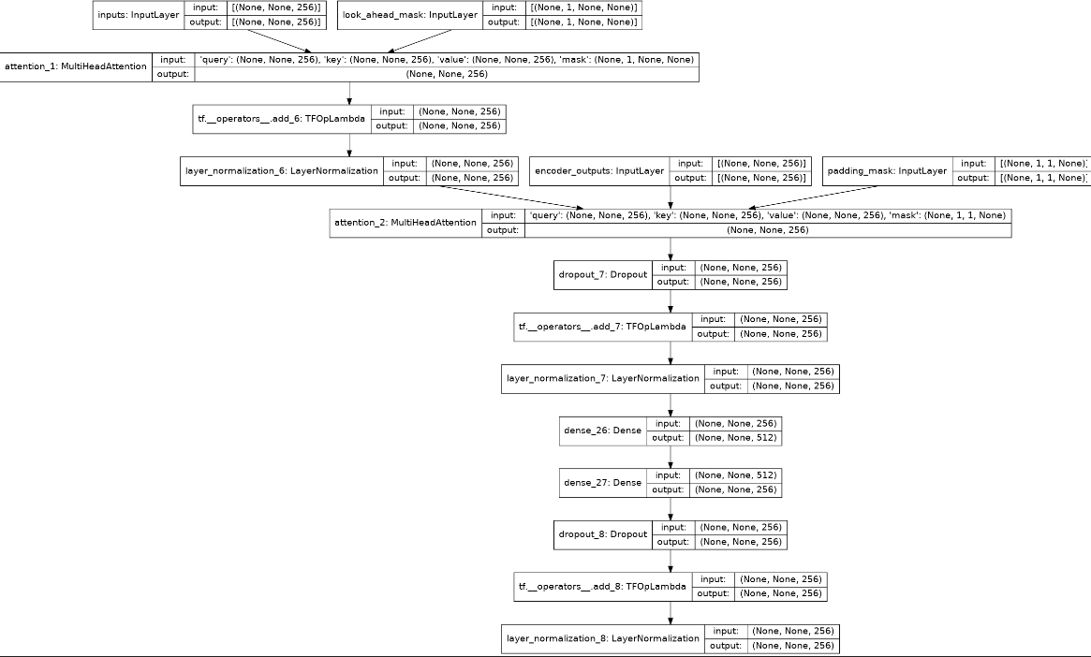

Slide 12
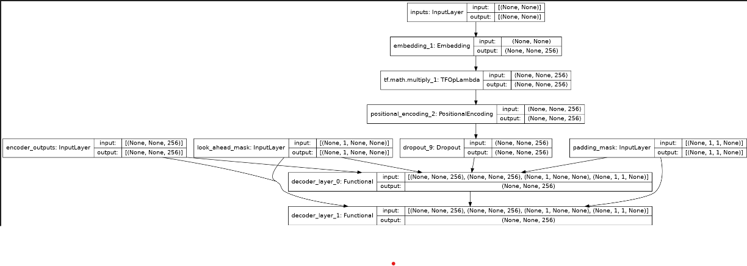

Slide 13
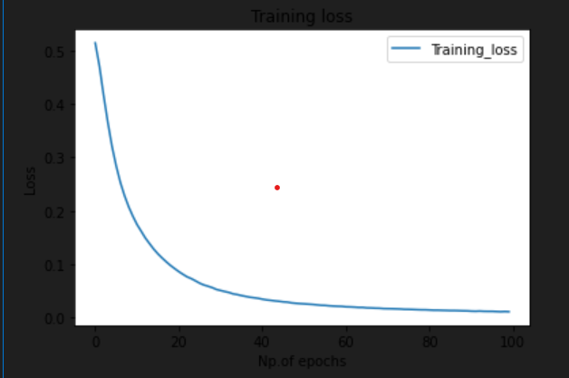
TRAINING lOSS

Slide 14
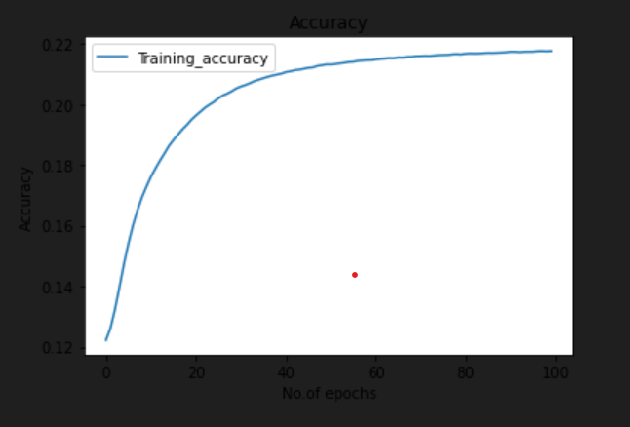
TRAINING ACCURACY

Slide 15
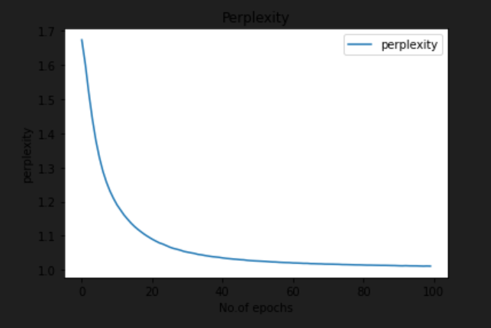
PERPLEXITY

